Slide 1
Your presentation title
Your name
This template was adapted from a presentation created by DASC 522 Fall 2020 student MSgt Guzowski
Last Updated: 19-Sep-23

Slide 2
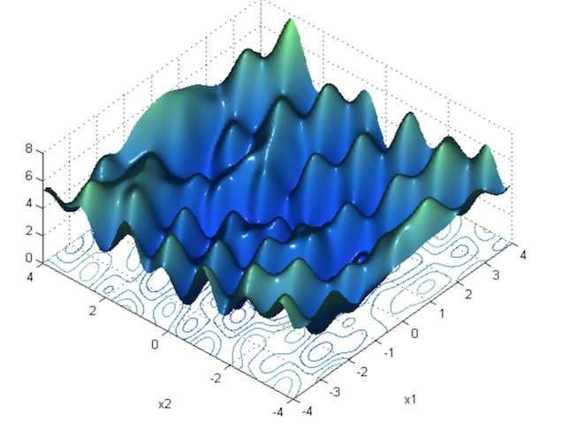
Overview
On this slide, verbally mention that the headings are aligned with the cross-industry standard process for data mining (CRISP-DM).
Mission Understanding
Data Understanding
Data Preparation
Classical Modeling
Neural Network Modeling
Evaluation & Deployment
Conclusion
This slide template has a lot of room on the right for appealing pictures (or informative graphs/tables).
If you use an internet graphic, paste the link like this example
https://towardsdatascience.com/neural-network-optimization-7ca72d4db3e0

Slide 3
Mission Understanding
Organization supported:
Background information about your topic (you could summarize section 1 of your paper)
This could be a good slide to cite references from your bibliography slide [1]

Slide 4
Mission Understanding
Research Question:
…
Success Criteria:
…

Slide 5
Data Understanding
Dataset details:
Sample consisted of enlisted members from FY19
357 Observations
260 Reenlisted
97 Did not reenlist
FY 19 Retention rate: 72.83%
8 Features
Bonus Eligibility
Years of Service
Pay Grade
Drill Pay
Reenlist
Service vs Resident State
Career Field
Air Force Specialty Code (AFSC)
Dataset Sample
INDEX | BONUS_ELIG | SVC_YRS | PAY_GRADE | DRILL_PAY | REENLIST | SVC_RES_STATE | CAREER_FIELD | AFSC
0 | 0 | 8 | E-5 | 106.9 | 1 | 1 | 3D | 3D0
1 | 1 | 8 | E-5 | 106.9 | 0 | 0 | 1N | 1N4
2 | 1 | 5 | E-5 | 93.48 | 0 | 1 | 1N | 1N0
3 | 0 | 17 | E-6 | 133 | 1 | 1 | 2A | 2A6
4 | 0 | 17 | E-7 | 153.66 | 1 | 1 | 4Y | 4Y0
Summary Statistics
 | MEAN | STD | MIN | 25% | 50% | 75% | MAX
BONUS_ELIG | 0.31 | 0.46 | 0 | 0 | 0 | 1 | 1
SVC_YRS | 10.4 | 6.07 | 2 | 5 | 8 | 14 | 34
DRILL_PAY | 116.06 | 29.93 | 70.19 | 93.48 | 106.9 | 131.38 | 261.63
REENLIST | 0.72 | 0.45 | 0 | 0 | 1 | 1 | 1
SVC_RES_STATE | 0.76 | 0.42 | 0 | 1 | 1 | 1 | 1

Slide 6
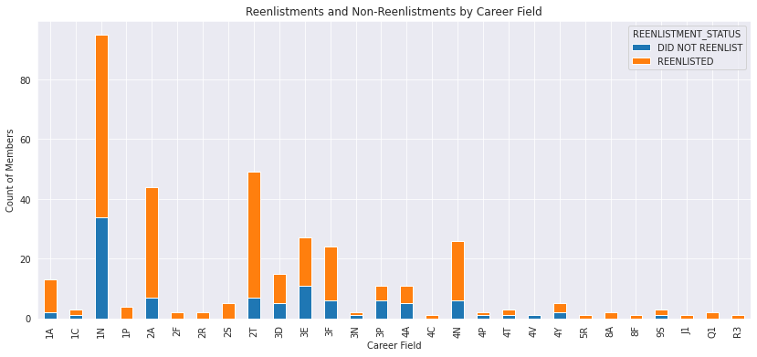
Data Understanding
Reenlistments and Non-Reenlistments by Career Field
The Intelligence career field’s low retention rate may be having an outsize impact on the overall retention rate, as it comprises 63% of all non-reenlistments
The low retention rates for Intelligence and Civil Engineering confirmed anecdotal information provided by the Career Advisor’s office
Career Fields with more than 20 Members
CAREER FIELD |  | COUNT | REENLISTED | REENLISTMENT PERCENTAGE
1N | Intelligence | 95 | 61 | 64.21%
2A | Aerospace Maintenance | 44 | 37 | 84.09%
2T | Vehicle Maintenance | 49 | 42 | 85.71%
3E | Civil Engineering | 27 | 16 | 59.26%
3F | Personnel | 24 | 18 | 75%
4N | Medical | 26 | 20 | 76.92%

Slide 7
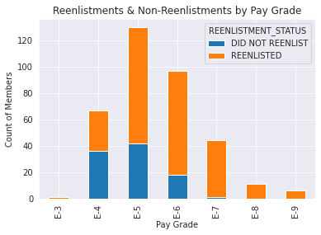
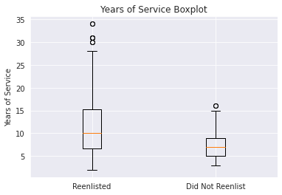
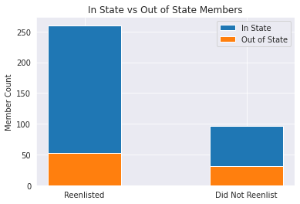
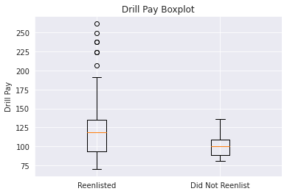
Data Understanding
Pay Grade
Years of Service
Members that are Senior Non-Commissioned Officers seem almost certain to reenlist.
Boxplot could indicate that members are more likely to reenlist after they hit the 15-year mark.
In State & Out of State Members
Drill Pay
Living out of state from a unit does not seem to tip the scale towards not reenlisting.
Boxplot could indicate that members making more than $125 per drill period may be more likely to reenlist.
You could select the 4 most important variables and discuss them

Slide 8
Data Preparation
Discuss cleaning, transformations, filtering etc
Discuss their impact on the data. Examples:
Did it change the distribution?
Did it change the number of datapoints?

Slide 9
Data Preparation
The chart below is optional, but could be used to summarize the DP process (transformations, filtering etc)
.
.
FY 2019 Loss Roster
FY 2019 Pay Tables
VPC PAS Codes
AFSC Bonus Eligibility
Oct 2018 Personnel Roster
Compare Personnel Rosters
FY 2019 Retention Records
Drop irrelevant records*
Final Dataset
MilPDS
Oct 2019 Personnel Roster

Slide 10
Classical Modeling - Method
Used Python 3.6 in the Google Colab (or other) IDE, and algorithms from the SciKit-Learn framework
Selected (algorithm) due to:
Small number of features
Small dataset
Only 2 outcomes to classify: Reenlist, or Not Reenlist
Conducted 3 iterations
Iteration 1: Selected 4 features
Iteration 2: Selected feature with lowest p-value
Iteration 3: Normalized numerical features and selected features with lowest p-values
Iteration 3 was the final selected model

Slide 11
Classical Modeling – Results (if Regression)
See “Guzowski comparison.xlsx” for an editable version of this

Slide 12
Classical Modeling – Results (if Classification)
See “Guzowski comparison.xlsx” for an editable version of this

Slide 13
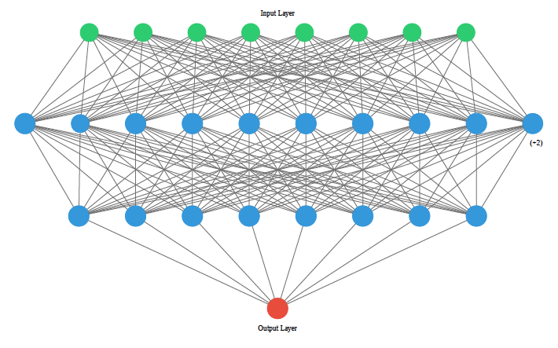
Neural Network Modeling - Method
Used Keras and TensorFlow frameworks within (your IDE)
Discuss the structure of your NN & choices that led to that, such as
Data quantity
Your type of problem (regression or classification)
Problem complexity
Etc.
Justify your choice of compile & fit parameters
Notes:
Note: ann_visualizer code below is broken due to a keras update, and it is not required for the final presentation
# create visualization
# must temporarily remove normalization layer, otherwise you will get an error
!pip3 install ann_visualizer
from ann_visualizer.visualize import ann_viz;
ann_viz(model, title="Pima Indian Diabetes Dataset NN")

Slide 14
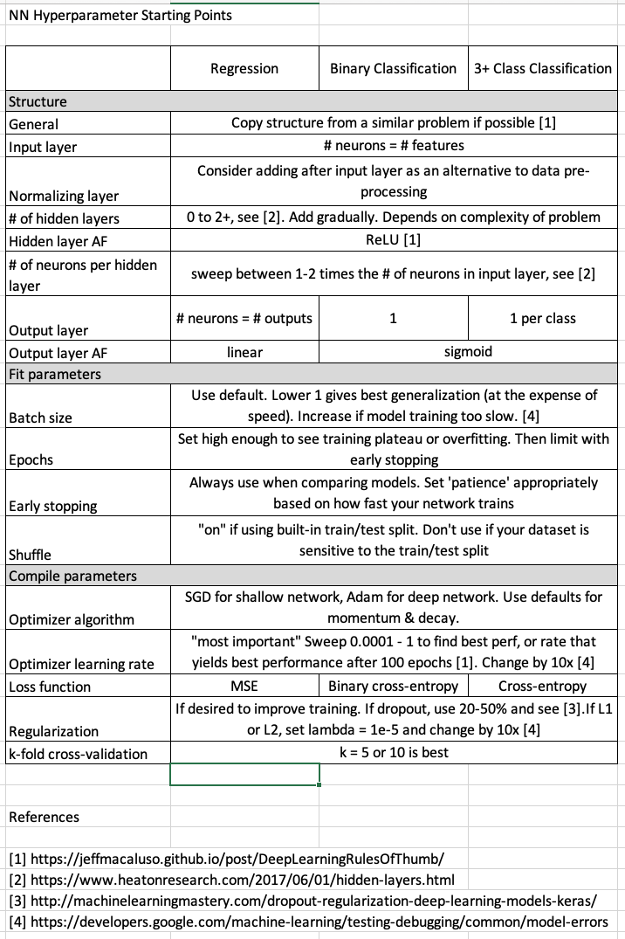
NN Method - Hyperparameter Sweeps
Tested 4 hyperparameter sweeps:
Iteration 1: Batch Size and Epochs
Batch sizes of 10, 20, 30
Epochs of 10, 50, 100
Iteration 2: Change Optimizer
Stochastic Gradient Descent to Adam
Iteration 3: Add additional complexity
Hidden Layer with 6 nodes
Regularization
Utilized Early Stopping Technique
Feel free to delete this!
https://towardsdatascience.com/a-i-enhanced-molecular-discovery-and-optimization-9434f3f8a593

Slide 15
NN Modeling – Results (if Regression)
See “Guzowski comparison.xlsx” for an editable version of this

Slide 16
NN Modeling – Results (if Classification)
See “Guzowski comparison.xlsx” for an editable version of this

Slide 17
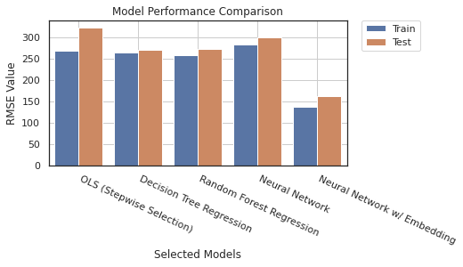
Evaluation
The example below is for regression, but for classification you could substitute accuracy or another metric for RMSE

Slide 18
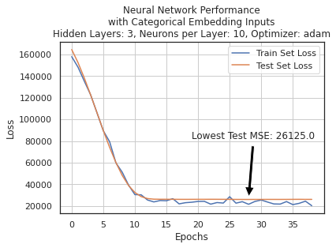
Evaluation - Final Model & Metrics
The final model selected was …
Be sure to discuss the performance difference between the training & test/holdout datasets

Slide 19
Deployment
Talk the audience through a simple application of your model, qualitative or quantitative. How can it be used to further the mission of your organization
Qualitative applications:
mention how you could apply inferences from classical modeling - here is an example from an AF Drug Testing Lab student:
Inference “younger, less educated individuals who exhibit sensation seeking behavior and are open to experience tend to be at higher risk for THC (pot) use”
Application: we recommend a personality survey for new employees, and focus drug prevention efforts on those at highest risk for TCH use
Quantitative applications:
how can you best use the prediction of the model to make a decision?
You could create an excel (or Python) analysis showing how a decision could be made
Be sure to mention the impact of that decision (i.e. we could save $500K, avoid 20% of space launch failures, or predeploy food aid to areas that have the highest risk for a food crisis
There are way too many words on this example slide – I just copied/pasted from the word template to give ideas

Slide 20
Conclusions
Main points from the conclusion of your paper
Avoid introducing new information here

Slide 21
Bibliography
Paste your word bibliography here, and cite sources using the IEEE format [1]. You don’t have to cite every source in your presentation.
[1] | P. K. Tong, M. G. Mattock, B. J. Asch, J. Hosek and F. Knutson, "Modeling Career Enlisted Aviator Retention in the U.S. Air Force," Rand Corporation, Santa Monica, 2020.
[2] | M. T. Ribeiro, S. Singh and C. Guestrin, ""Why Should I Trust You?" Explaining the Predictions of Any Classifier," in Proceedings of the 2016 Conference of the North American Chapter of the Association for Computational Linguistics: Demonstrations, San Diego, 2016.
[3] | L. M. Harrington, J. H. Bigelow, A. Rothenberg, J. Pita and P. D. Emslie, "A Methodology for Modeling the Flow of Military Personnel Across Air Force Active and Reserve Components," Rand Corporation, Santa Monica, 2016.
[4] | H. L. Jantscher, "An Examination of Economic Metrics as Indicators of Air Force Retention," Air Force Institute of Technology, vol. 365, 2016.
[5] | T. S. Pujats, "Forecasting Attrition by AFSC for the United States Air Force," Air Force Institute of Technology, vol. 3200, 2020.
[6] | J. T. Zimmerman, "Application of Enlisted Force Retention Levels and Career Field Stability," Air Force Institute of Technology, vol. 805, 2017.
[7] | V. L. Wiggins, S. K. Engquist and L. T. Looper, "Applying Neural Networks to Air Force Personnel Analysis," Human Resources Directorate Manpower and Personnel Research Division, Brooks Air Force Base, 1992.
[8] | J. A. Schofield, "Non-Rated Air Force Line Officer Attrition Rates Using Survival Analysis," Air Force Institute of Technology, vol. 131, 2015.
[9] | J. T. Elliot, "Air Force Officer Attrition: An Econometric Analysis," Air Force Institute of Technology, vol. 2075, 2018.
[10] | X. Zhu, "Forecasting Employee Turnover in Large Organizations," University of Tennessee, vol. 3985, 2016.

